Slide 1


The Kent Secondary Admissions
Procedure 2026/27
Parent Guide
Application for a school place
Tests
Selection Process
Notes:
1

Slide 2
Timescale
Key Date: | Event
Monday 2nd June 2025 | Registration for the Kent Test Opens
Tuesday 1st July 2025 | Registration for the Kent Test Closes
Thursday 5th June 2025 at 5pm | Parent meeting at Warden House (In Elephants Classroom)
Tuesday 10th June 2025 6pm - 8pm | Dover Grammar School for Girls Open Evening
Wednesday 11th June 2025 & Thursday 12th June 2025 (9.30am – 11:30am) | Dover Grammar School for Girls Open Day Tours begin Booking Link: https://forms.office.com/e/k1i5JnGMTu
Wednesday 25th June 2025 at 5pm | Information evening at Dover Grammar School for Boys regarding their admissions test https://forms.office.com/e/9cwe02X83f
Friday 4th July 2025 | Deadline for registering to take the Dover Boys’ Grammar School Admissions Test Application link: https://forms.office.com/e/8XvCv21CwJ

Slide 3
Timescale ​
Key Date: | Event
Friday 11th July 2025 | Deadline for registering to take the Dover Girls’ Grammar School Admissions Test Application link: https://dggs.applicaa.com/entranceexam
Thursday 11th September 2025 | Kent Test takes place at Warden House for registered pupils
Saturday 13th September 2025 | Dover Boys and Dover Girls Grammar School Admission Tests take place
Thursday 16th October 2025 | Assessment Decision sent to parents
Friday 31st October 2025 | Deadline to complete secondary common application (SCAF) form.

Slide 4
The LEA will act as a clearing house for all applications
1. Where a child is eligible for a place at only one of the nominated schools, that school will be offered.
2. Where a child is eligible for a place at two or more of the nominated schools, they will be allocated a place at whichever of these is the highest ranked preference.
3. Where a child is not eligible for a place at any of the nominated schools, the child will be allocated a place at the nearest appropriate school with a vacancy.
Notes:
4

Slide 5
You can only appeal to a school you have nominated on your child’s SCAF form
Parents must confirm their acceptance of the school offered
If you are refused a place at your preferred school you can request to be placed on a waiting list or could appeal against the decision
Notes:
5

Slide 6
In Summary
Stage 1
Parents register their child to
take the Kent Test
by 1st July 2025 as well as the
relevant Dover Grammar Tests
Stage 2
Children sit the Kent test
in September and parents
are notified of the outcome
in October 2025
Stage 3
Parents complete
The SCAF in October
and are notified of the
outcome in March 2026
Notes:
6

Slide 7
How PESE Test Works
Takes place at Warden House on Thursday 11th September 2025
The current test was introduced in 2015 produced by Granada Learning Assessment
No Practice test – just practice questions
English and Maths Test in multiple choice format (c.60 minutes plus admin time, two separate sections each with introductory practice items, English first);
Reasoning Test in multiple choice format (c.60 minutes plus admin time, one Verbal-Reasoning section, one non-verbal reasoning and one special reasoning test.
Writing exercise 40 mins
Notes:
7

Slide 8
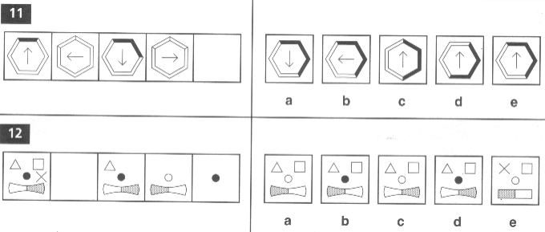
Non- Verbal + Spatial Reasoning
Notes:
8

Slide 9
Verbal Reasoning
This tests the children’s ability to reason with words and language
Find the next pair of letters in this sequence: CQ DQ EP FP ….
Answer: GO
If the code for FOOT is ENNS, what is the code for TOE?
Answer: SND
Notes:
9

Slide 10
Mathematics
This test is similar to the end of Year 6 tests, however the answers are multiple-choice.
The prominent difference is that questions will push for the higher ability to calculate and reason.
Notes:
10

Slide 11
Writing
This test is a short writing activity under test conditions. This test will only be looked at where a child’s test scores are just below the threshold for grammar selection. This will not be marked and will not affect your child’s standardised score.
Notes:
11

Slide 12
To be selected as suitable for grammar school:
In 2024 a child needed to score an aggregate of over 332 in all tests to be assessed as grammar.
The threshold for grammar selection was 106 on each test.
Please note: this is different to our internal CAT tests where the grammar threshold would be between 110-120 based on the older pre-2015 tests.
If your child falls just below the threshold, and the Headteacher (in consultation with class teachers) decides to make an appeal, their writing task will be considered as further evidence alongside work in school books.
Notes:
12

Slide 13
Access Arrangements
Some children may be entitled to access arrangements to help them access the Kent Test or Dover Grammar Tests.
If you feel that your child may need special arrangements to help them access the Kent Test, please contact our Assistant Headteacher, Mrs. Lynne Moore by Friday 14th June to discuss this further.
Access arrangement for the Dover Grammar tests MUST be discussed by the parents/carers with the individual Grammar school.
Notes:
13

Slide 14
Sir Roger Manwood’s School
Sir Roger Manwood's School - Admissions
Open Evening: Tuesday 1st July 2025 (5.30pm - 7.30pm)

Slide 15
Dover Girls and Boys
Entrance Tests
Saturday 14th September 2024 - entrance test for Dover Boys and Girls Grammar Schools
Parents MUST contact each school separately to register by
Dover Boys - Friday 4th July 2025.
Dover Girls - Friday 11th July 2025.
Please check carefully the deadlines for both of the schools.
Usually four tests between 25 and 50 minutes each
Verbal Reasoning, Non-Verbal Reasoning Mathematics and English.
Contact the schools’ directly or check their websites for dates of open evenings and registration forms.
Dover Girls Details: http://www.dggs.kent.sch.uk/
Dover Boys Details: http://www.dgsb.co.uk

Slide 16
Dover Girls and Boys
Dover Girls Details: http://www.dggs.kent.sch.uk/
Dover Boys Details: http://www.dgsb.co.uk
Tuesday 10th June 2025 6pm - 8pm | Dover Grammar School for Girls Open Evening
Wednesday 11th June 2025 & Thursday 13th June 2025 (9.30am - 11.30am) | Dover Grammar School for Girls Open Day Tours begin Booking Link: https://forms.office.com/e/k1i5JnGMTu
Wednesday 25th June 2025 at 5pm | Information evening at Dover Grammar School for Boys regarding their admissions test https://forms.office.com/e/9cwe02X83f

Slide 17
Goodwin Academy
Admissions, Goodwin Academy
Grammar stream for approx. 30 pupils. This has developed since then and may continue in 2024. Contact the school for further details.
Opening morning tours:
Monday 30th September to Friday 4th October 2025

Slide 18
Sandwich Technology School
Admissions - Sandwich Technology School
There is now no technical aptitude test for admissions and these are now based solely on their published admissions criteria.
There is no preference for Warden House families and children are admitted to Sandwich Technology School following their agreed admissions criteria.
Summer Open Evening: Tuesday 1st July 2025 (5.30pm - 7.30pm)

Slide 19

St Edmund's Catholic School
Admissions - St Edmund's Catholic School
​
​
Open Evening: Wednesday 24th September 2025
5.00pm – 8.00pm
Open morning tours: Monday 29th September to Friday 3rd October 2025 9.00am – 9.45am
Events - St Edmund's Catholic School

Slide 20
What happens next?
If you wish your child to attend a grammar school you must register them for the Kent Test by Monday 1st July 2025.
Ensure you look as closely as is possible at all the schools you are interested in, if you are interested in Dover Boys or Girls, enrol to take their entrance tests. Some schools, like Dover Girls Grammar are organising tours this term.
Remember, the decision is yours, although you must involve your child in the discussions and hear their opinions.
Notes:
20

Slide 21

Finally…
This can be a potentially pressure laden time for you and your child.
Use our advice and guidance, talk to us and one another about the issues.
When we visit our Year 7 children, children are always well settled and enjoy the new chapter in their education!
Notes:
21

Slide 22
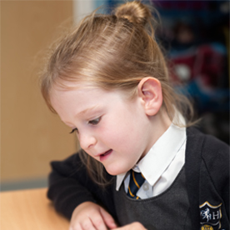
Contacts
http://www.kent.gov.uk/education-and-children/schools/school-places/kent-test
Emma Burgess - Admissions manager 03000416678 kent.admissions@kent.gov.uk
or email
office@warden-house.kent.sch.uk
Notes:
22

